Slide 1


Machine Learning model on:
Credit Card Prediction Analysis

Slide 2

Overview
Objective and Importance
Data Collection
Feature Engineering
Methodology and Model Selection
Results and Analysis
Conclusion
Q&A Session

Slide 3
Objective
Build a machine learning model to predict if an applicant is eligible to get a credit card or not.
Importance
provides accuracy
reduces risk
helps provide personalized credit offers
improves operational efficiency

Slide 4

Data Collection
Source :
https://www.kaggle.com/datasets
Data Used:
Used two datasets,
❖ Credit record
❖ Application record of the users
We used the personal information and data submitted by credit card applicants to predict the probability of future defaults and credit card borrowings.

Slide 5
Data Collection
❖ Credit record :
438557 rows × 18 columns
❖ Application record of the users :
1.1048575 rows × 3 columns
Final DataFrame:
❖ credit_approval_df
9516 rows × 18 columns

Slide 6


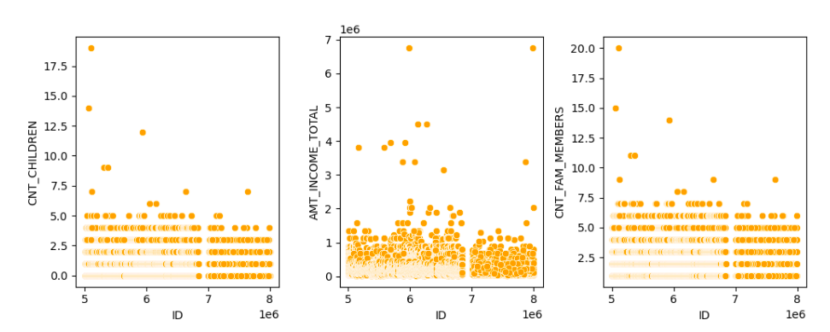

Feature Engineering:
Grouped columns into specific class /"status"
Null values and duplicates
Outliers
1: overdue
0: closed
Dropped them.
Trimmed them.

Slide 7



Feature Engineering:
Encoded the Nominal and Ordinal dataframes
Classified the dataframe
Divided the categorical dataframe
numerical and categorical
Nominal and Ordinal
Nominal: Label Encoder
Ordinal: Ordinal Encoder

Slide 8

Feature Engineering:
‘credit_approval_df’
merged the datasets into one final dataframe

Slide 9
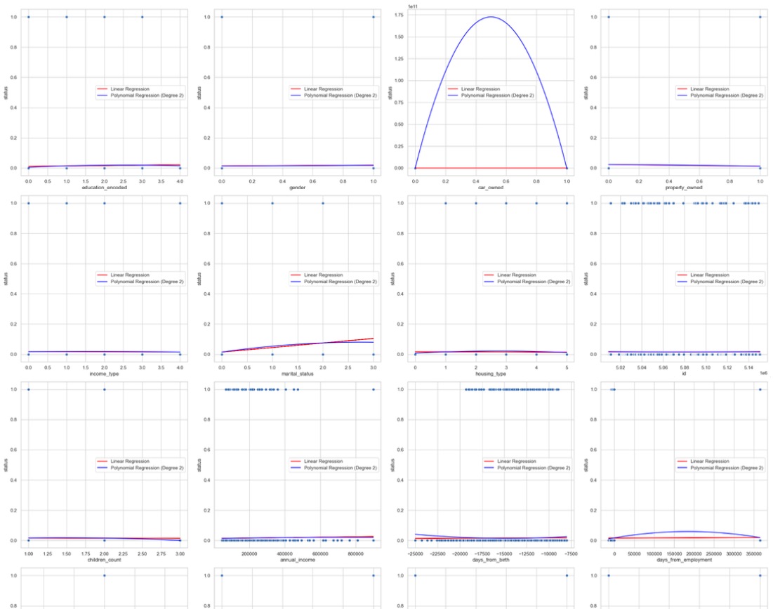

Step 1
Checked for correlation between the input variable and output variable
non-linear

Slide 10


Step 2
Step 3
Decided on a machine algorithm to use
Split X and y train-test
scaled using MinMax Scaler
XGBoost
hasbetter classification
report with non-linear correlation
Step 5
Model testing
Step 4
tested using Logistic Regression and XGBoost
dealt with Oversampling
used smote()
XGBoost have better results !

Slide 11

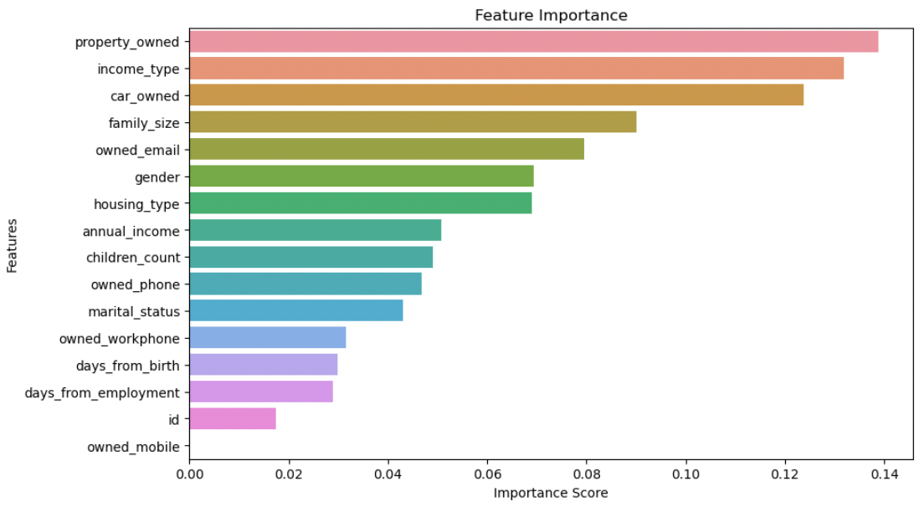
Feature Importance:
property owned, income type , car_owned and family size have a significant impact on credit card approval.

Slide 12
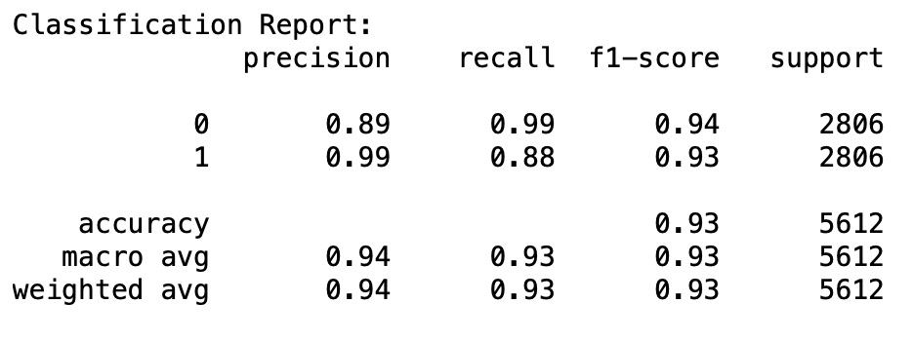

Model Performance
predictive model demonstrated good performance.

Slide 13


Conclusion
Applicants with higher incomes, a positive credit history, and stable employment are more likely to be approved for a credit card.
Challenge:
Synthetic Minority Over-sampling Technique
smote ( )
imbalance in the dataset
X and y have a 99:1 ratio
possibility of overfitting
synthetic samples may not capture the same level of
meaningful information as the original data.

Slide 14


Slide 15


